Slide 1
Python
Create By Raman (ramansharma95@gmail.com)

Slide 2
Introduction
Python is a general-purpose interpreted, interactive, object-oriented, and high-level programming language. It was created by Guido van Rossum during 1985- 1990. Like Perl, Python source code is also available under the GNU General Public License (GPL).
Python has a simple coding style which is easy to catch with a little knowledge and the right tools. Hence, it is the preferred language for beginners planning to make a career in Programming.
Python has applications in a variety of areas be they are desktop apps, web apps, data mining or machine learning.
You can make websites, create games, use it for web scrapping, robotics, and browser automation, i.e., using Selenium with Python. And almost everything that any object-oriented programming language can do.

Slide 3
Introduction
Code Quality.
Developer Productivity.
Code Portability.
Built-In And External Libraries.
Free To Use, Modify And Redistribute
Free To Use, Modify And Redistribute
Object-Oriented From The Core

Slide 4
Python Programming Domains
Web Application Development.(frameworks (WAF) like Django, Flask, CherryPy, and Bottle which give extensive support for web development.)
Scientific And Numeric Computing(specialized modules like NumPy, SciPy, Pandas, matplotlib, and IPython.)
GUI Programming(Python’s clean syntax and tremendous support of many GUI libraries (like wxWidgets, pyqt or pyside)

Slide 5
Course Content-Basic
Overview
Environment Setup
Basic Syntax
Decision Making
Loops
Numbers
Strings
Lists
Tuples
Dictionary
Date & Time
Functions
Modules
File I/O
Exceptions

Slide 6
Course Content-Advance
Classes/Objects
Reg Expression
CGI Programing
Database Access
Networking
Sending Emails
Multithreading
XML Processing
GUI Programing
Further Extensions.

Slide 7
Lecture 1 :- Setup the Environment & Basic Syntax

Slide 8

How to install python
Go to https://www.python.org/
Click on Downloads tab and download latest version (3.6.5)
Run the python setup to install it.
Configure the path into the windows Environment variable PATH
To start python shell or CLI , go to command prompt and run python it will show window like below, where we can write & execute python commands or scripts.

Slide 9
Python Documentation
Go to https://www.python.org/
Select the “Documentation” Tab where you can find the documentation.

Slide 10
Python Editor
Pycharm
Anaconda

Slide 11
Simplest Calculator in Python
The interactive Python interpreter can be used as a powerful calculator.
print(2+2)# 4
print(2*3) # 6
print(15/2)# 7.5
print(15//2)#7
print(15%2)#1
Width=30
Height=50
print(Width*Height)# 1500

Slide 12
Lecture 2 Basics of Python Programming

Slide 13
Python 2.x vs Python 3.x

Slide 14
The print Function
Most notable and most widely known change in Python 3 is how the print function is used. Use of parenthesis () with print function is now mandatory. It was optional in Python 2.
print "Hello World" #is acceptable in Python 2
print ("Hello World") # in Python 3, print must be followed by ()
The print() function inserts a new line at the end, by default. In Python 2, it can be suppressed by putting ',' at the end. In Python 3, "end=' '" appends space instead of newline.
print x, # Trailing comma suppresses newline in Python 2
print(x, end=" ") # Appends a space instead of a newline in Python 3

Slide 15
Reading Input from Keyboard
Python 2 has two versions of input functions, input() and raw_input(). The input() function treats the received data as string if it is included in quotes '' or "", otherwise the data is treated as number.
In Python 3, raw_input() function is deprecated. Further, the received data is always treated as string.

Slide 16
Input Data (input() and raw_input())
Python 2 | Python3
>>> x=input('something:') something:10 #entered data is treated as number >>> x 10 >>> x=input('something:') something:'10' #entered data is treated as string >>> x '10‘ >>> x=raw_input("something:") something:10 #entered data is treated as string even without '‘ >>> x '10' >>> x=raw_input("something:") something:'10' #entered data treated as string including '‘ >>> x "'10'" | >>> x=input("something:") something:10 >>> x '10' >>> x=input("something:") something:'10' #entered data treated as string with or without '' >>> x "'10'" >>> x=raw_input("something:") # will result NameError Traceback (most recent call last): File "", line 1, in x=raw_input("something:") NameError: name 'raw_input' is not defined

Slide 17
Integer Division
In Python 2, the result of division of two integers is rounded to the nearest integer. As a result, 3/2 will show 1. In order to obtain a floating-point division, numerator or denominator must be explicitly used as float. Hence, either 3.0/2 or 3/2.0 or 3.0/2.0 will result in 1.5
Python 3 evaluates 3 / 2 as 1.5 by default, which is more intuitive for new programmers.

Slide 18
Unicode representation
Python 2 requires you to mark a string with a u if you want to store it as Unicode.
Python 3 stores strings as Unicode, by default. We have Unicode (utf-8) strings, and 2 byte classes: byte and byte arrays.

Slide 19
xrange() Function Removed
In Python 2 range() returns a list, and xrange() returns an object that will only generate the items in the range when needed, saving memory.
In Python 3, the range() function is removed, and xrange() has been renamed as range(). In addition, the range() object supports slicing in Python 3.2 and later

Slide 20
Raise exception
Python 2 accepts both notations, the 'old' and the 'new' syntax; Python 3 raises a SyntaxError if we do not enclose the exception argument in parenthesis.
raise IOError, "file error" #This is accepted in Python 2
raise IOError("file error") #This is also accepted in Python 2
raise IOError, "file error" #syntax error is raised in Python 3
raise IOError("file error") #this is the recommended syntax in Python 3

Slide 21
Python 3
Type the following command on the python interpreter and press enter
>>>print(“Hello Python 3.6.5”)

Slide 22
Script Mode programming
Create a file with extension .py and write print(“Hello world”) into that and save the file(say C:\Temp\Test.py).
Open command prompt and write following command
python C:\Temp\Test.py
It will give you the output as HelloWorld

Slide 23
Python Identifiers
A Python identifier is a name used to identify a variable, function, class, module or other object. An identifier starts with a letter A to Z or a to z or an underscore (_) followed by zero or more letters, underscores and digits (0 to 9).
Python does not allow punctuation characters such as @, $, and % within identifiers. Python is a case sensitive programming language.

Slide 24
Python Identifiers
Here are naming conventions for Python identifiers −
Class names start with an uppercase letter. All other identifiers start with a lowercase letter.
Starting an identifier with a single leading underscore indicates that the identifier is private.
Starting an identifier with two leading underscores indicates a strong private identifier.
If the identifier also ends with two trailing underscores, the identifier is a language-defined special name.

Slide 25
Reserve words
and | exec | not
as | finally | or
assert | for | pass
break | from | print
class | global | raise
continue | if | return
def | import | try
del | in | while
elif | is | with
else | lambda | yield
except

Slide 26
Line and Indentation
Python does not use braces({}) to indicate blocks of code for class and function definitions or flow control. Blocks of code are denoted by line indentation, which is rigidly enforced.
The number of spaces in the indentation is variable, but all statements within the block must be indented the same amount.

Slide 27
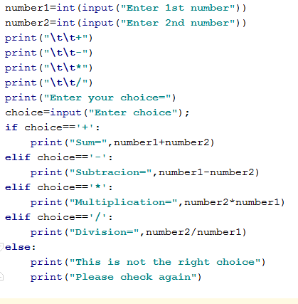
Line and Indentation Example

Slide 28


Multiline Statement
Statements in Python typically end with a new line. Python, however, allows the use of the line continuation character (\) to denote that the line should continue.
The statements contained within the [], {}, or () brackets do not need to use th line continuation character.

Slide 29
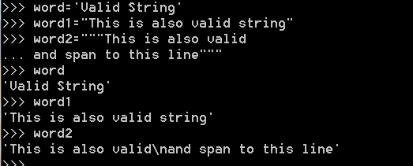
Quotation in Python
Python accepts single ('), double (") and triple (''' or """) quotes to denote string literals, as long as the same type of quote starts and ends the string.
The triple quotes are used to span the string across multiple lines.

Slide 30

Comments in Python
A hash sign (#) that is not inside a string literal is the beginning of a comment. All characters after the #, up to the end of the physical line, are part of the comment and the Python interpreter ignores them.
Python does not have multiple-line commenting feature

Slide 31

Waiting for the User
You can use input() to ask user to press enter the key to end the program or to wait.

Slide 32

Multiple Statements on a Single Line
The semicolon ( ; ) allows multiple statements on a single line given that no statement starts a new code block.

Slide 33
Multiple Statement Groups as Suites
Groups of individual statements, which make a single code block are called suites in Python. Compound or complex statements, such as if, while, def, and class require a header line and a suite.
Header lines begin the statement (with the keyword) and terminate with a colon ( : ) and are followed by one or more lines which make up the suite.

Slide 34
Lecture 3

Slide 35
Variables
Variables are nothing but reserved memory locations to store values. It means that when you create a variable, you reserve some space in the memory.
Based on the data type of a variable, the interpreter allocates memory and decides what can be stored in the reserved memory. Therefore, by assigning different data types to the variables, you can store integers, decimals or characters in these variables.

Slide 36
Assigning Values to Variables
Python variables do not need explicit declaration to reserve memory space. The declaration happens automatically when you assign a value to a variable. The equal sign (=) is used to assign values to variables.
The operand to the left of the = operator is the name of the variable and the operand to the right of the = operator is the value stored in the variable.
counter = 100 # An integer assignment
miles = 1000.0 # A floating point
name = "John" # A string

Slide 37
Multiple Assignment
Python allows you to assign a single value to several variables simultaneously.
For example −a = b = c = 1
a, b, c = 1, 2, "john"
Here, two integer objects with values 1 and 2 are assigned to the variables a and b respectively, and one string object with the value "john" is assigned to the variable c.

Slide 38
Standard Data Types
Numbers
String
List
Tuple
Dictionary

Slide 39
Numbers
var =1
var1=2
del var #delete a single object or multiple objects by using the del statement.
print(var)#NameError: name 'var' is not defined

Slide 40
Number Types
int (signed integers)
float (floating point real values)
complex (complex numbers)

Slide 41
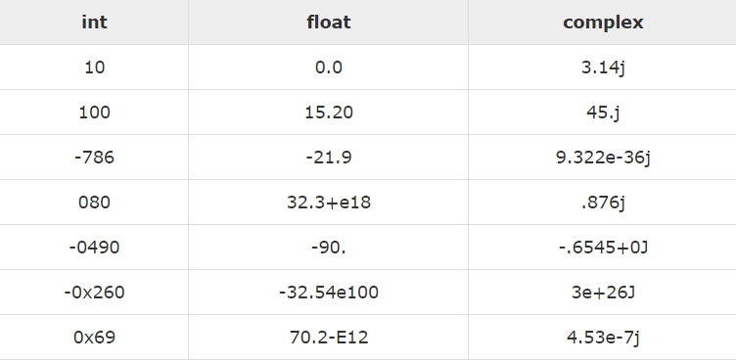
Numbers Example

Slide 42
Number examples
Int
Z=1
Float
Z=1.0
Complex
z=2-6j
print(type(z))
print(z.real)
print(z.imag)

Slide 43
Strings
Strings in Python are identified as a contiguous set of characters represented in the quotation marks. Python allows either pair of single or double quotes. Subsets of strings can be taken using the slice operator ([ ] and [:] ) with indexes starting at 0 in the beginning of the string and working their way from -1 to the end.
The plus (+) sign is the string concatenation operator and the asterisk (*) is the repetition operator
Len() is used to find the length of the string eg to find the length of variable name will be len(name)

Slide 44
String Example
str = 'Hello World!'
print (str) # Prints complete string
print (str[0]) # Prints first character of the string
print (str[2:5]) # Prints characters starting from 3rd to 5th
print (str[2:]) # Prints string starting from 3rd character
print (str * 2) # Prints string two times
print (str + "TEST") # Prints concatenated string

Slide 45
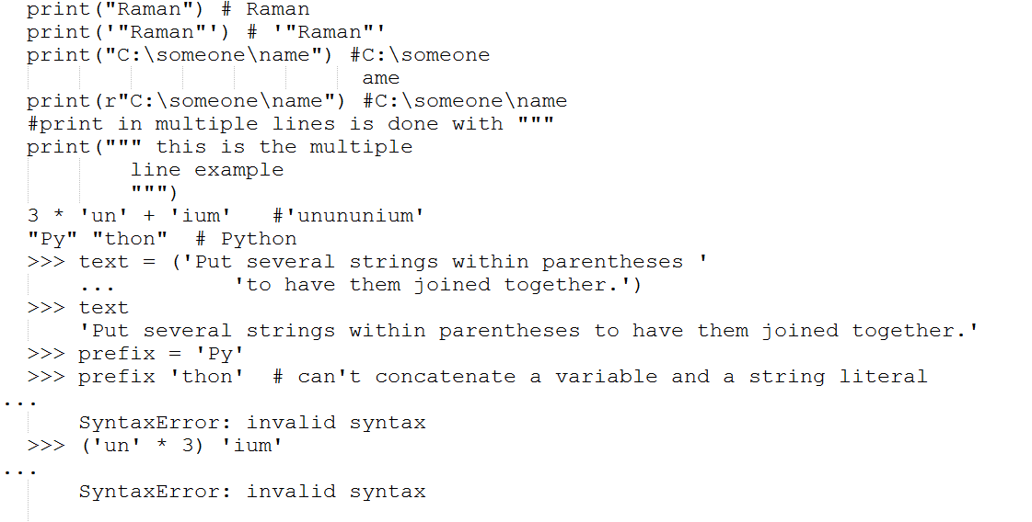
String Examples

Slide 46
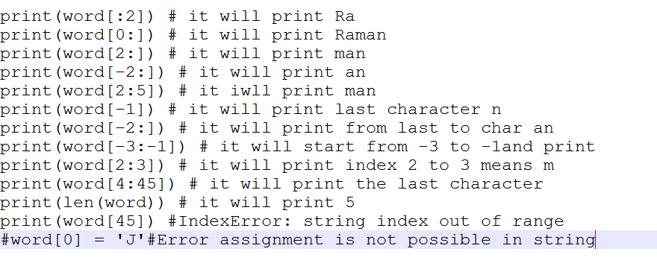
String Examples

Slide 48
Lists
Lists are the most versatile of Python's compound data types. A list contains items separated by commas and enclosed within square brackets ([]). To some extent, lists are similar to arrays in C. One of the differences between them is that all the items belonging to a list can be of different data type.
The values stored in a list can be accessed using the slice operator ([ ] and [:]) with indexes starting at 0 in the beginning of the list and working their way to end -1. The plus (+) sign is the list concatenation operator, and the asterisk (*) is the repetition operator

Slide 49
List Example
list = [ 'abcd', 786 , 2.23, 'john', 70.2 ]
tinylist = [123, 'john']
print (list) # Prints complete list
print (list[0]) # Prints first element of the list
print (list[1:3]) # Prints elements starting from 2nd till 3rd
print (list[2:]) # Prints elements starting from 3rd element
print (tinylist * 2) # Prints list two times
print (list + tinylist) # Prints concatenated lists

Slide 50
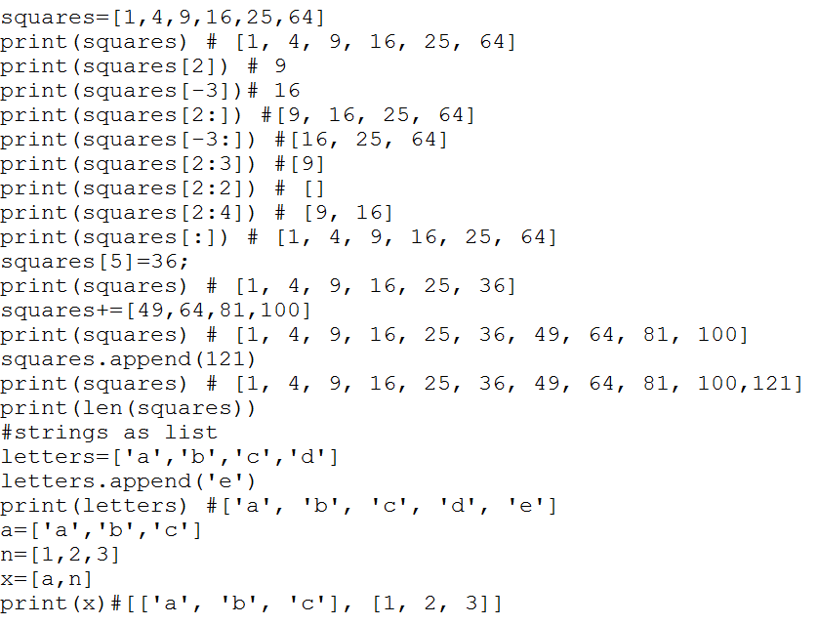
List Examples

Slide 51
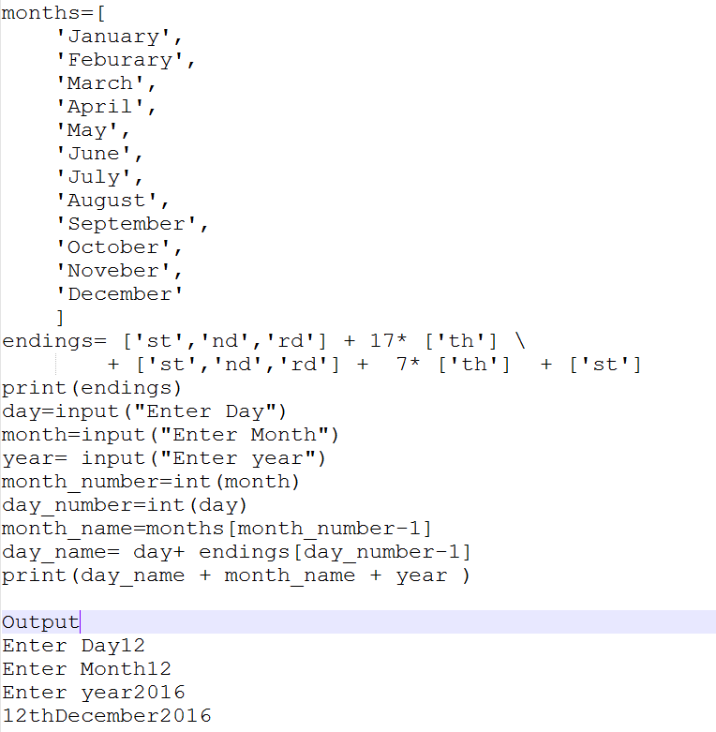
Simple List Program

Slide 52
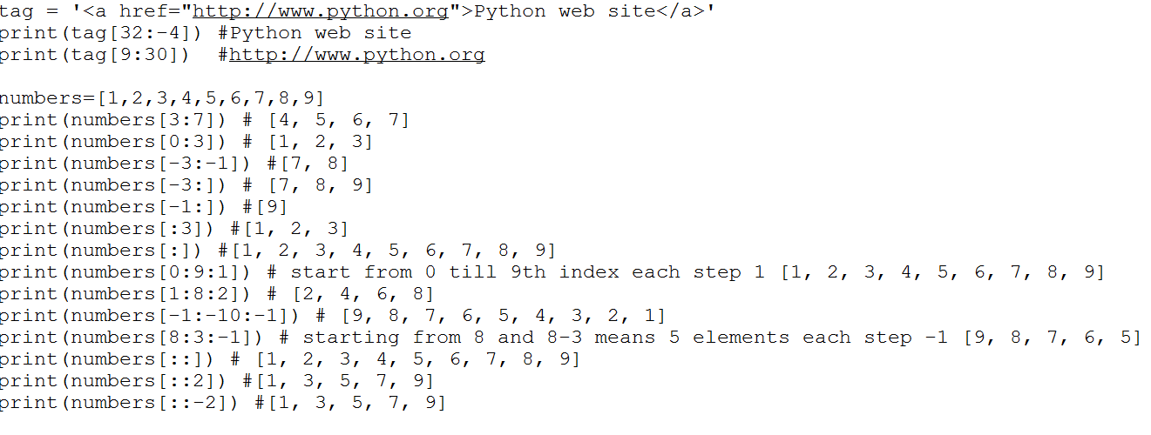
Slicing –To access range of elements

Slide 53
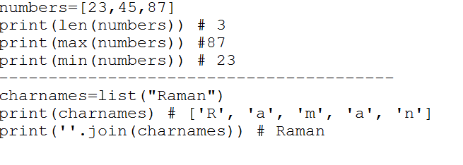
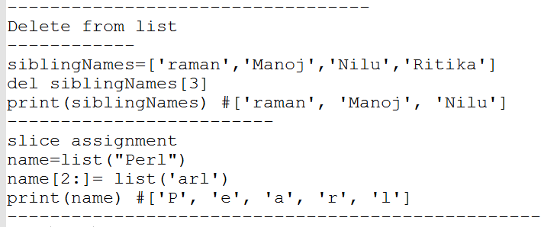
List Examples

Slide 54
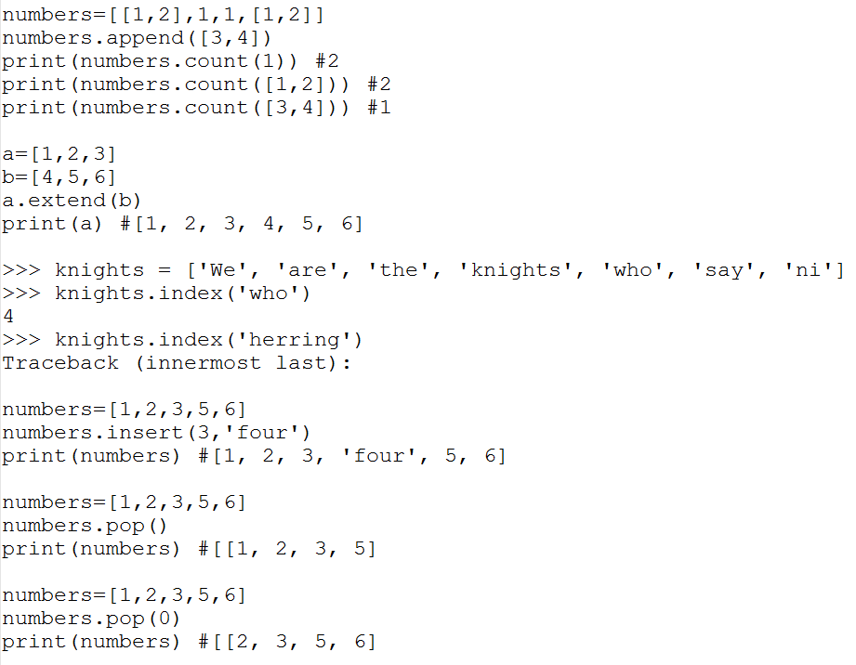
List methods

Slide 55
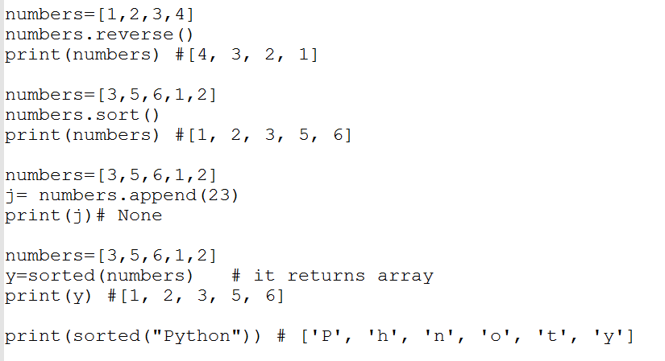
List methods

Slide 56
Lecture 4

Slide 57
Tuples
A tuple is another sequence data type that is similar to the list. A tuple consists of a number of values separated by commas. Unlike lists, however, tuples are enclosed within parenthesis.
The main difference between lists and tuples are − Lists are enclosed in brackets ( [ ] ) and their elements and size can be changed, while tuples are enclosed in parentheses ( ( ) ) and cannot be updated. Tuples can be thought of as read-only lists

Slide 58
Tuple Examples
tuple = ( 'abcd', 786 , 2.23, 'john', 70.2 )
tinytuple = (123, 'john')
print (tuple) # Prints complete tuple
print (tuple[0]) # Prints first element of the tuple
print (tuple[1:3]) # Prints elements starting from 2nd till 3rd
print (tuple[2:]) # Prints elements starting from 3rd element
print (tinytuple * 2) # Prints tuple two times
print (tuple + tinytuple) # Prints concatenated tuple

Slide 59
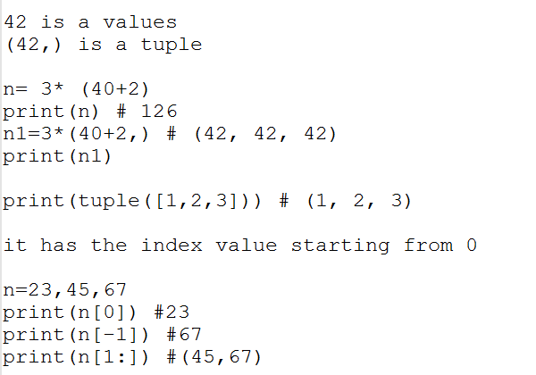
Tuple Examples

Slide 60
Dictionary
Python's dictionaries are kind of hash-table type. They work like associative arrays or hashes found in Perl and consist of key-value pairs. A dictionary key can be almost any Python type, but are usually numbers or strings. Values, on the other hand, can be any arbitrary Python object.
Dictionaries are enclosed by curly braces ({ }) and values can be assigned and accessed using square braces ([]).

Slide 61
Dictionary Example
dict = {}
dict['one'] = "This is one"
dict[2] = "This is two"
tinydict = {'name': 'john','code':6734, 'dept': 'sales'}
print (dict['one']) # Prints value for 'one' key
print (dict[2]) # Prints value for 2 key
print (tinydict) # Prints complete dictionary
print (tinydict.keys()) # Prints all the keys
print (tinydict.values()) # Prints all the values

Slide 62
Data Type Conversion
S.No. | Function & Description
1 | int(x [,base]) Converts x to an integer. The base specifies the base if x is a string.
2 | float(x) Converts x to a floating-point number.
3 | complex(real [,imag]) Creates a complex number.
4 | str(x) Converts object x to a string representation.
5 | repr(x) Converts object x to an expression string.
6 | eval(str) Evaluates a string and returns an object.
7 | tuple(s) Converts s to a tuple.
8 | list(s) Converts s to a list.
9 | set(s) Converts s to a set.
10 | dict(d) Creates a dictionary. d must be a sequence of (key,value) tuples.
11 | frozenset(s) Converts s to a frozen set.
12 | chr(x) Converts an integer to a character.
13 | unichr(x) Converts an integer to a Unicode character.
14 | ord(x) Converts a single character to its integer value.
15 | hex(x) Converts an integer to a hexadecimal string.
16 | oct(x) Converts an integer to an octal string.

Slide 63
Type of Operators
Arithmetic Operators
Comparison (Relational) Operators
Assignment Operators
Logical Operators
Bitwise Operators
Membership Operators
Identity Operators

Slide 64
Arithmetic Operator
Operator | Description | Example
+ Addition | Adds values on either side of the operator. | a + b = 31
- Subtraction | Subtracts right hand operand from left hand operand. | a – b = -11
* Multiplication | Multiplies values on either side of the operator | a * b = 210
/ Division | Divides left hand operand by right hand operand | b / a = 2.1
% Modulus | Divides left hand operand by right hand operand and returns remainder | b % a = 1
** Exponent | Performs exponential (power) calculation on operators | a**b =10 to the power 20
// | Floor Division - The division of operands where the result is the quotient in which the digits after the decimal point are removed. But if one of the operands is negative, the result is floored, i.e., rounded away from zero (towards negative infinity): | 9//2 = 4 and 9.0//2.0 = 4.0, -11//3 = -4, -11.0//3 = -4.0

Slide 65
Comparison Operators
Operator | Description | Example
== | If the values of two operands are equal, then the condition becomes true. | (a == b) is not true.
!= | If values of two operands are not equal, then condition becomes true. | (a!= b) is true.
> | If the value of left operand is greater than the value of right operand, then condition becomes true. | (a > b) is not true.
< | If the value of left operand is less than the value of right operand, then condition becomes true. | (a < b) is true.
>= | If the value of left operand is greater than or equal to the value of right operand, then condition becomes true. | (a >= b) is not true.
<= | If the value of left operand is less than or equal to the value of right operand, then condition becomes true. | (a <= b) is true.

Slide 66
Assignment Operators
Operator | Description | Example
= | Assigns values from right side operands to left side operand | c = a + b assigns value of a + b into c
+= Add AND | It adds right operand to the left operand and assign the result to left operand | c += a is equivalent to c = c + a
-= Subtract AND | It subtracts right operand from the left operand and assign the result to left operand | c -= a is equivalent to c = c - a
*= Multiply AND | It multiplies right operand with the left operand and assign the result to left operand | c *= a is equivalent to c = c * a
/= Divide AND | It divides left operand with the right operand and assign the result to left operand | c /= a is equivalent to c = c / a
%= Modulus AND | It takes modulus using two operands and assign the result to left operand | c %= a is equivalent to c = c % a
**= Exponent AND | Performs exponential (power) calculation on operators and assign value to the left operand | c **= a is equivalent to c = c ** a
//= Floor Division | It performs floor division on operators and assign value to the left operand | c //= a is equivalent to c = c // a

Slide 67
Bitwise Operator
Operator | Description | Example
& Binary AND | Operator copies a bit, to the result, if it exists in both operands | (a & b) (means 0000 1100)
| Binary OR | It copies a bit, if it exists in either operand. | (a | b) = 61 (means 0011 1101)
^ Binary XOR | It copies the bit, if it is set in one operand but not both. | (a ^ b) = 49 (means 0011 0001)
~ Binary Ones Complement | It is unary and has the effect of 'flipping' bits. | (~a ) = -61 (means 1100 0011 in 2's complement form due to a signed binary number.
<< Binary Left Shift | The left operand's value is moved left by the number of bits specified by the right operand. | a << = 240 (means 1111 0000)
>> Binary Right Shift | The left operand's value is moved right by the number of bits specified by the right operand. | a >> = 15 (means 0000 1111)

Slide 68
Logical Operator
Operator | Description | Example
and Logical AND | If both the operands are true then condition becomes true. | (a and b) is False.
or Logical OR | If any of the two operands are non-zero then condition becomes true. | (a or b) is True.
not Logical NOT | Used to reverse the logical state of its operand. | Not(a and b) is True.

Slide 69
Membership Operator
Operator | Description | Example
in | Evaluates to true if it finds a variable in the specified sequence and false otherwise. | x in y, here in results in a 1 if x is a member of sequence y.
not in | Evaluates to true if it does not finds a variable in the specified sequence and false otherwise. | x not in y, here not in results in a 1 if x is not a member of sequence y.

Slide 70
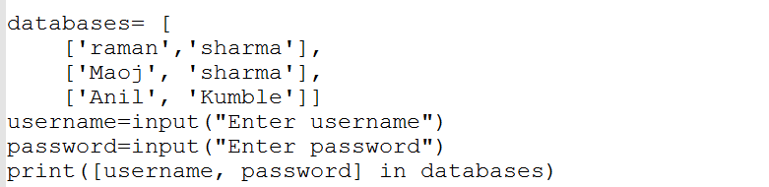
Membership Examples

Slide 71
Identity Operator
Operator | Description | Example
is | Evaluates to true if the variables on either side of the operator point to the same object and false otherwise. | x is y, here is results in 1 if id(x) equals id(y).
is not | Evaluates to false if the variables on either side of the operator point to the same object and true otherwise. | x is not y, here is notresults in 1 if id(x) is not equal to id(y).

Slide 72
Decision Making Statement
S.No. | Statement & Description
1 | if statementsAn if statement consists of a boolean expression followed by one or more statements.
2 | if...else statementsAn if statement can be followed by an optional else statement, which executes when the boolean expression is FALSE.
3 | nested if statementsYou can use one if or else if statement inside another if or else ifstatement(s).

Slide 73
Loops
S.No. | Loop Type & Description
1 | while loopRepeats a statement or group of statements while a given condition is TRUE. It tests the condition before executing the loop body.
2 | for loopExecutes a sequence of statements multiple times and abbreviates the code that manages the loop variable.
3 | nested loopsYou can use one or more loop inside any another while, or for loop.

Slide 74
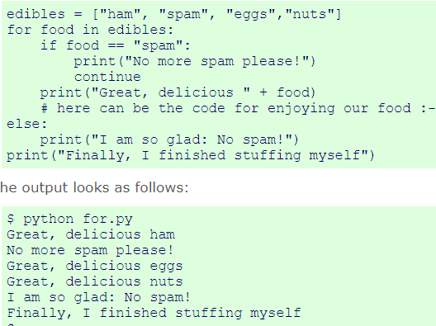

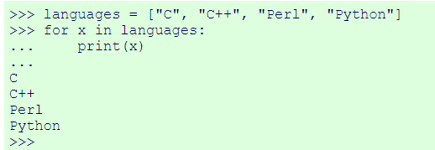
Loop Example

Slide 75


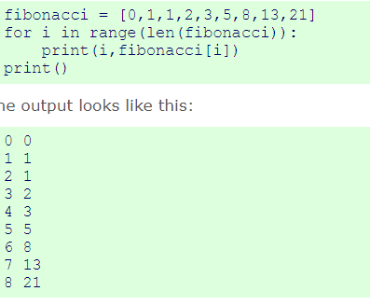
range Examples

Slide 76
Control statements
S.No. | Control Statement & Description
1 | break statementTerminates the loop statement and transfers execution to the statement immediately following the loop.
2 | continue statementCauses the loop to skip the remainder of its body and immediately retest its condition prior to reiterating.
3 | pass statementThe pass statement in Python is used when a statement is required syntactically but you do not want any command or code to execute.

Slide 77
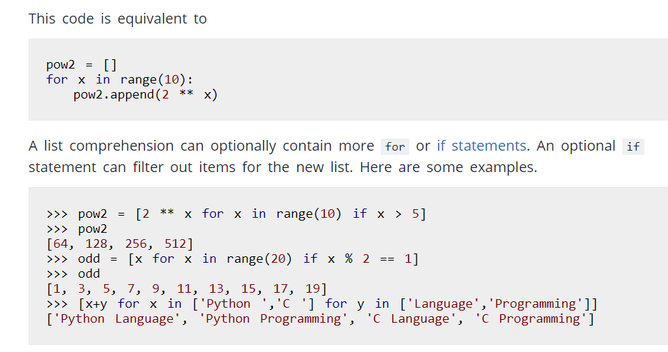
Some examples for loop with List

Slide 78
Lecture 5

Slide 79
Date & Time
A Python program can handle date and time in several ways. Converting between date formats is a common chore for computers. Python's time and calendar modules help track dates and times.

Slide 80

What is Tick?
Time intervals are floating-point numbers in units of seconds. Particular instants in time are expressed in seconds since 12:00am, January 1, 1970(epoch).
There is a popular time module available in Python which provides functions for working with times, and for converting between representations. The function time.time() returns the current system time in ticks since 12:00am, January 1, 1970(epoch).

Slide 81
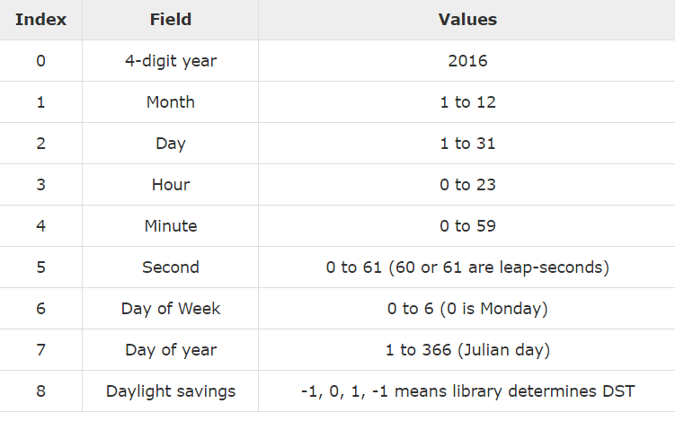
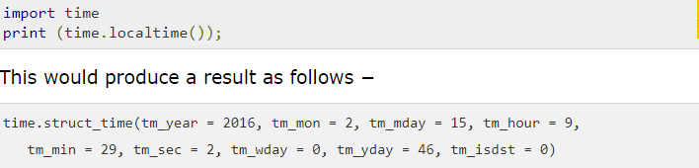
Time Tuple

Slide 82
Formatted Time
You can format any time as per your requirement, but a simple method to get time in a readable format is asctime() −
import time
localtime = time.asctime( time.localtime(time.time()) )
print ("Local current time :", localtime)

Slide 83
Calendar
import calendar
cal = calendar.month(2016, 2)
print ("Here is the calendar:")
print (cal) # it will print the calendar of Feb2,2016

Slide 84
Functions
A function is a block of organized, reusable code that is used to perform a single, related action. Functions provide better modularity for your application and a high degree of code reusing.
As you already know, Python gives you many built-in functions like print(), etc. but you can also create your own functions. These functions are called user-defined functions.

Slide 85
Defining Functions
Function blocks begin with the keyword def followed by the function name and parentheses ( ( ) ).
Any input parameters or arguments should be placed within these parentheses. You can also define parameters inside these parentheses.
The first statement of a function can be an optional statement - the documentation string of the function or docstring.
The code block within every function starts with a colon (:) and is indented.
The statement return [expression] exits a function, optionally passing back an expression to the caller. A return statement with no arguments is the same as return None.

Slide 86
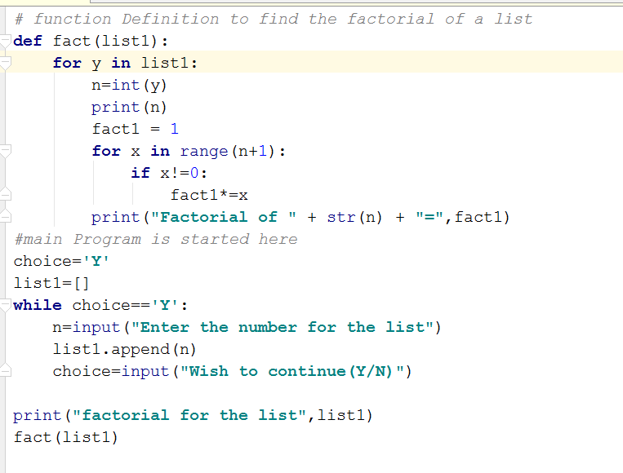
Find Factorial of a list

Slide 87


Function syntax

Slide 88
Defining a function gives it a name, specifies the parameters that are to be included in the function and structures the blocks of code.
Once the basic structure of a function is finalized, you can execute it by calling it from another function or directly from the Python prompt. Following is an example to call the printme() function −

Slide 89
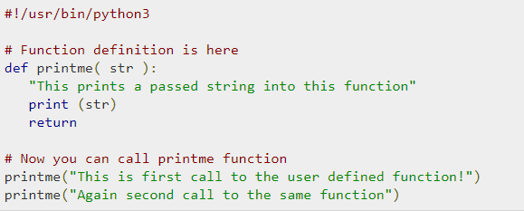
Calling function

Slide 90
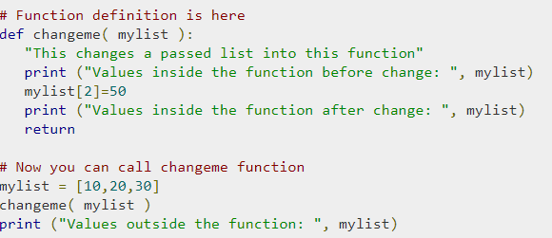

Pass by Reference
All parameters (arguments) in the Python language are passed by reference. It means if you change what a parameter refers to within a function, the change also reflects back in the calling function.

Slide 91
Function Arguments
Required arguments
Keyword arguments
Default arguments
Variable-length arguments

Slide 92
Required Argument
Required arguments are the arguments passed to a function in correct positional order. Here, the number of arguments in the function call should match exactly with the function definition.
To call the function printme(), you definitely need to pass one argument, otherwise it gives a syntax error

Slide 93
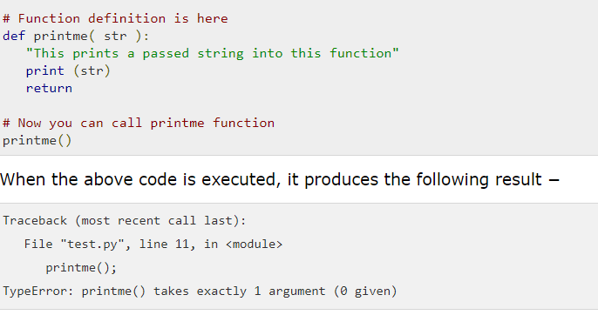
Required Arguments

Slide 94
Keyword Arguments
Keyword arguments are related to the function calls. When you use keyword arguments in a function call, the caller identifies the arguments by the parameter name.
This allows you to skip arguments or place them out of order because the Python interpreter is able to use the keywords provided to match the values with parameters. You can also make keyword calls to the printme() function in the following ways

Slide 95
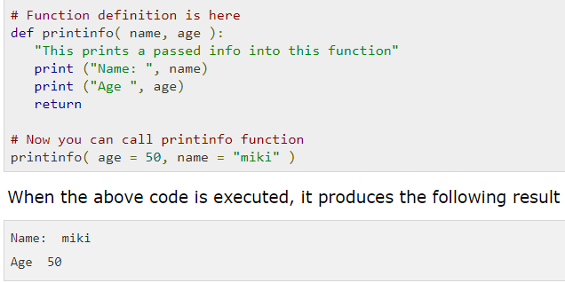
Keyword argument

Slide 96
Default Argument
A default argument is an argument that assumes a default value if a value is not provided in the function call for that argument. The following example gives an idea on default arguments, it prints default age if it is not passed

Slide 97
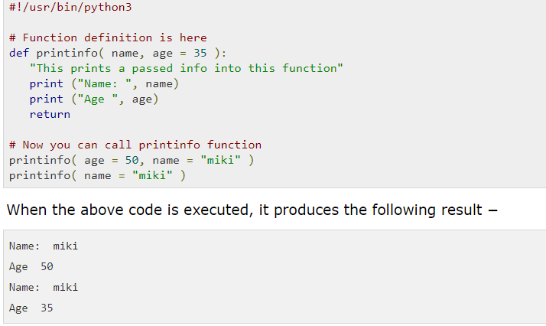
Default Arguments

Slide 98

Variable-length Arguments
You may need to process a function for more arguments than you specified while defining the function. These arguments are called variable-lengtharguments and are not named in the function definition, unlike required and default arguments.

Slide 99
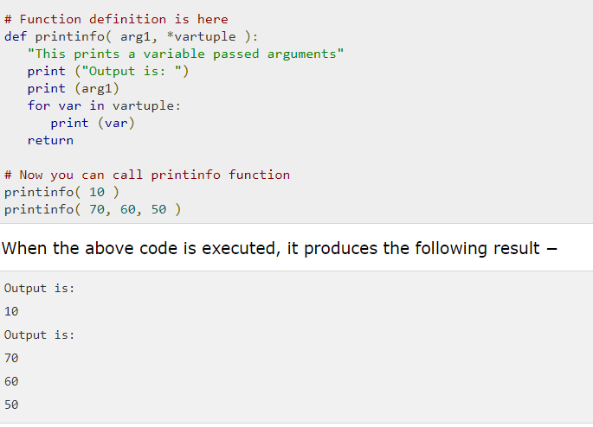
Variable- Length Arguments

Slide 100
Anonymous Function
These functions are called anonymous because they are not declared in the standard manner by using the def keyword. You can use the lambda keyword to create small anonymous functions.
Lambda forms can take any number of arguments but return just one value in the form of an expression. They cannot contain commands or multiple expressions.
An anonymous function cannot be a direct call to print because lambda requires an expression.
Lambda functions have their own local namespace and cannot access variables other than those in their parameter list and those in the global namespace.
Although it appears that lambdas are a one-line version of a function, they are not equivalent to inline statements in C or C++, whose purpose is to stack allocation by passing function, during invocation for performance reasons.

Slide 101
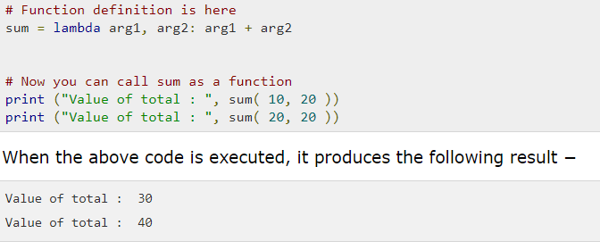
Anonymous Function

Slide 102
return statement
The statement return [expression] exits a function, optionally passing back an expression to the caller. A return statement with no arguments is the same as return None.
All the examples given below are not returning any value. You can return a value from a function as follows −

Slide 103
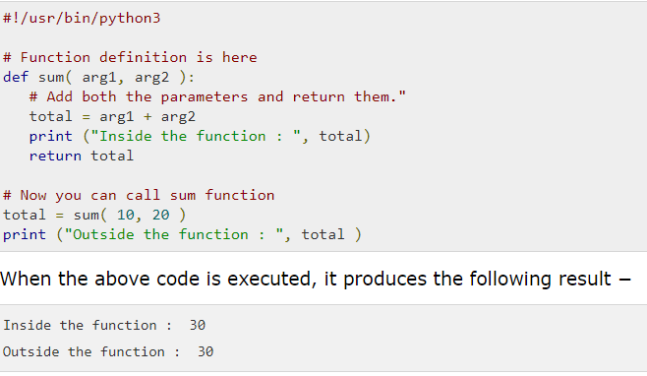
return statement

Slide 104
Lecture 6

Slide 105
Modules
A module allows you to logically organize your Python code. Grouping related code into a module makes the code easier to understand and use. A module is a Python object with arbitrarily named attributes that you can bind and reference.
Simply, a module is a file consisting of Python code. A module can define functions, classes and variables. A module can also include runnable code.

Slide 106
import Statement
You can use any Python source file as a module by executing an import statement in some other Python source file
When the interpreter encounters an import statement, it imports the module if the module is present in the search path. A search path is a list of directories that the interpreter searches before importing a module.
A module is loaded only once, regardless of the number of times it is imported. This prevents the module execution from happening repeatedly, if multiple imports occur.

Slide 107
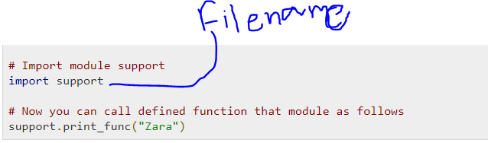
Module example

Slide 108
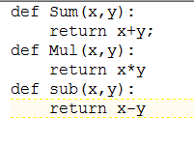
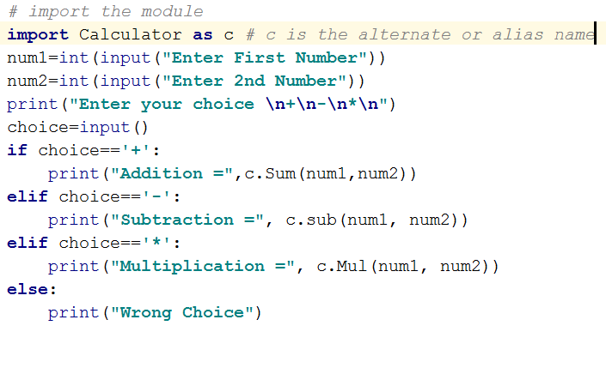
Activity
Create a module called Calculator which has 3 functions Addition,Subtraction,Multiplication of any 2 valid numbers.
Solution:-
First Create a file called Calculator.py in the same folder of your project which will have following code

Slide 109
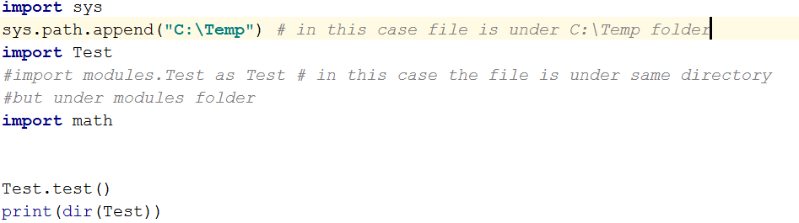
Examples

Slide 110
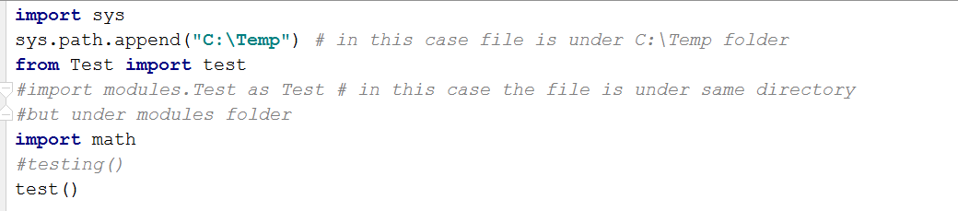
The from...import Statement
Python's from statement lets you import specific attributes from a module into the current namespace.

Slide 111
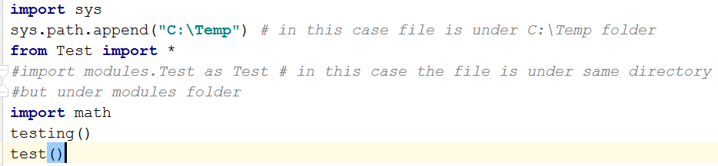
The from...import * Statement
It is also possible to import all the names from a module into the current namespace by using the following import statement −

Slide 112
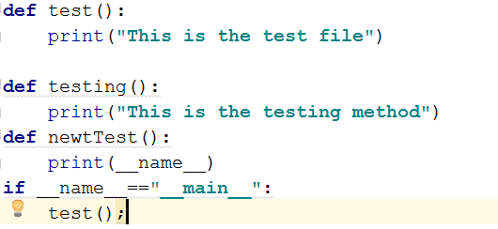
Executing Modules as Scripts
Within a module, the module’s name (as a string) is available as the value of the global variable __name__. The code in the module will be executed, just as if you imported it, but with the __name__ set to "__main__".

Slide 113
Namespaces and Scoping
Variables are names (identifiers) that map to objects. A namespace is a dictionary of variable names (keys) and their corresponding objects (values).
A Python statement can access variables in a local namespace and in the global namespace. If a local and a global variable have the same name, the local variable shadows the global variable.
Each function has its own local namespace. Class methods follow the same scoping rule as ordinary functions.
Python makes educated guesses on whether variables are local or global. It assumes that any variable assigned a value in a function is local.
Therefore, in order to assign a value to a global variable within a function, you must first use the global statement.
The statement global VarName tells Python that VarName is a global variable. Python stops searching the local namespace for the variable.

Slide 114
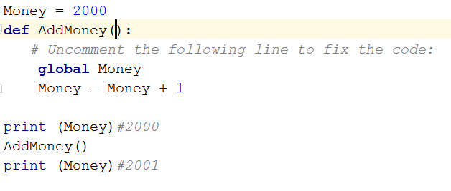
Example
For example, we define a variable Money in the global namespace. Within the function Money, we assign Money a value, therefore Python assumes Money as a local variable.
However, we accessed the value of the local variable Money before setting it, so an UnboundLocalError is the result. Uncommenting the global statement fixes the problem.

Slide 115
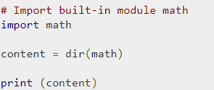
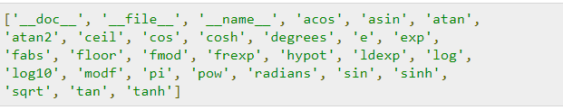
The dir( ) Function
The dir() built-in function returns a sorted list of strings containing the names defined by a module.
The list contains the names of all the modules, variables and functions that are defined in a module.

Slide 116

Packages in Python
A package is a hierarchical file directory structure that defines a single Python application environment that consists of modules and subpackages and sub-subpackages, and so on.
Consider a file Pots.py available in Phone directory. This file has the following line of source code −

Slide 117
Packages in Python
Similar, we have other two files having different functions with the same name as above. They are −
Phone/Isdn.py file having function Isdn()
Phone/G3.py file having function G3()
Now, create one more file __init__.py in the Phone directory −
Phone/__init__.py
To make all of your functions available when you have imported Phone, you need to put explicit import statements in __init__.py as follows

Slide 118

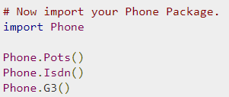
Packages in Python
After you add these lines to __init__.py, you have all of these classes available when you import the Phone package.

Slide 119
Lecture 7 File Operations
Python provides basic functions and methods necessary to manipulate files by default. You can do most of the file manipulation using a file object.

Slide 120
The open Function
Before you can read or write a file, you have to open it using Python's built-in open() function. This function creates a file object, which would be utilized to call other support methods associated with it.
file object = open(file_name [, access_mode][, buffering])

Slide 121
Pramaters
file_name − The file_name argument is a string value that contains the name of the file that you want to access.
access_mode − The access_mode determines the mode in which the file has to be opened, i.e., read, write, append, etc. A complete list of possible values is given below in the table. This is an optional parameter and the default file access mode is read (r).
buffering − If the buffering value is set to 0, no buffering takes place. If the buffering value is 1, line buffering is performed while accessing a file. If you specify the buffering value as an integer greater than 1, then buffering action is performed with the indicated buffer size. If negative, the buffer size is the system default(default behavior).

Slide 122
Mode and Description
S.No. | Mode & Description
1 | r Opens a file for reading only. The file pointer is placed at the beginning of the file. This is the default mode.
2 | rb Opens a file for reading only in binary format. The file pointer is placed at the beginning of the file. This is the default mode.
3 | r+ Opens a file for both reading and writing. The file pointer placed at the beginning of the file.
4 | rb+ Opens a file for both reading and writing in binary format. The file pointer placed at the beginning of the file.
5 | w Opens a file for writing only. Overwrites the file if the file exists. If the file does not exist, creates a new file for writing.
6 | wb Opens a file for writing only in binary format. Overwrites the file if the file exists. If the file does not exist, creates a new file for writing.
7 | w+ Opens a file for both writing and reading. Overwrites the existing file if the file exists. If the file does not exist, creates a new file for reading and writing.
8 | wb+ Opens a file for both writing and reading in binary format. Overwrites the existing file if the file exists. If the file does not exist, creates a new file for reading and writing.
9 | a Opens a file for appending. The file pointer is at the end of the file if the file exists. That is, the file is in the append mode. If the file does not exist, it creates a new file for writing.
10 | ab Opens a file for appending in binary format. The file pointer is at the end of the file if the file exists. That is, the file is in the append mode. If the file does not exist, it creates a new file for writing.
11 | a+ Opens a file for both appending and reading. The file pointer is at the end of the file if the file exists. The file opens in the append mode. If the file does not exist, it creates a new file for reading and writing.
12 | ab+ Opens a file for both appending and reading in binary format. The file pointer is at the end of the file if the file exists. The file opens in the append mode. If the file does not exist, it creates a new file for reading and writing.

Slide 123
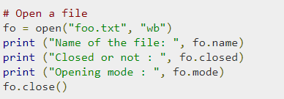

Example

Slide 124
The close() Method
The close() method of a file object flushes any unwritten information and closes the file object, after which no more writing can be done.
Python automatically closes a file when the reference object of a file is reassigned to another file. It is a good practice to use the close() method to close a file.

Slide 125
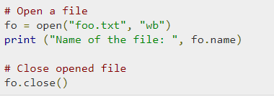
Example

Slide 126
The write() Method
The write() method writes any string to an open file. It is important to note that Python strings can have binary data and not just text.
The write() method does not add a newline character ('\n') to the end of the string

Slide 127
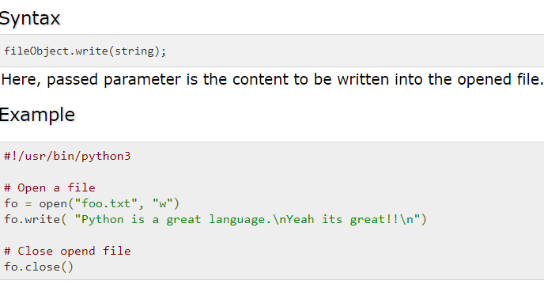
Syntax and Example

Slide 128
Lecture 8

Slide 129
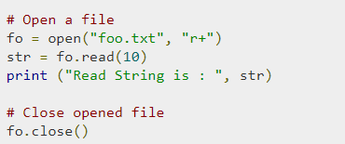
The read() Method
The read() method reads a string from an open file. It is important to note that Python strings can have binary data. apart from text data

Slide 130
File Positions
The tell() method tells you the current position within the file; in other words, the next read or write will occur at that many bytes from the beginning of the file.
The seek(offset[, from]) method changes the current file position. The offsetargument indicates the number of bytes to be moved. The from argument specifies the reference position from where the bytes are to be moved.
If from is set to 0, the beginning of the file is used as the reference position. If it is set to 1, the current position is used as the reference position. If it is set to 2 then the end of the file would be taken as the reference position.

Slide 131
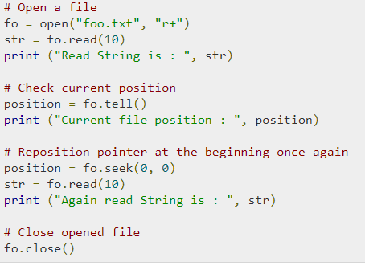
Example

Slide 132

Renaming and Deleting Files
Python os module provides methods that help you perform file-processing operations, such as renaming and deleting files.
To use this module, you need to import it first and then you can call any related functions.
The rename() method takes two arguments, the current filename and the new filename.

Slide 133

remove()
You can use the remove() method to delete files by supplying the name of the file to be deleted as the argument.

Slide 134

The mkdir() Method
You can use the mkdir() method of the os module to create directories in the current directory. You need to supply an argument to this method, which contains the name of the directory to be created.

Slide 135

The chdir() Method
You can use the chdir() method to change the current directory. The chdir() method takes an argument, which is the name of the directory that you want to make the current directory.

Slide 136

The getcwd() Method
The getcwd() method displays the current working directory.

Slide 137

The rmdir() Method
The rmdir() method deletes the directory, which is passed as an argument in the method.
Before removing a directory, all the contents in it should be removed.

Slide 138
Lecture 9 Exception Handling

Slide 139
Exception Handling
Exception Handling − This would be covered in this tutorial. Here is a list standard Exceptions available in Python − Standard Exceptions.
Assertions − This would be covered in Assertions in Python 3tutorial.

Slide 140
Standard Exception
Exception:->Base class for all exceptions
StopIteration:-Raised when the next() method of an iterator does not point to any object.
SystemExit:->Raised by the sys.exit() function.
ArithmeticError:->Base class for all errors that occur for numeric calculation.
OverflowError:->Raised when a calculation exceeds maximum limit for a numeric type.

Slide 141
Exception
An exception is an event, which occurs during the execution of a program that disrupts the normal flow of the program's instructions. In general, when a Python script encounters a situation that it cannot cope with, it raises an exception. An exception is a Python object that represents an error.
When a Python script raises an exception, it must either handle the exception immediately otherwise it terminates and quits.

Slide 142
Handling an exception
If you have some suspicious code that may raise an exception, you can defend your program by placing the suspicious code in a try: block. After the try: block, include an except: statement, followed by a block of code which handles the problem as elegantly as possible.

Slide 143
Syntax
try:
You do your operations here
......................
except ExceptionI:
If there is ExceptionI, then execute this block.
except ExceptionII:
If there is ExceptionII, then execute this block.
......................
else:
If there is no exception then execute this block.

Slide 144
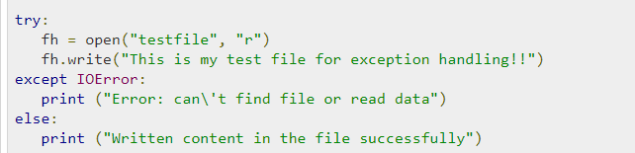
Example

Slide 145
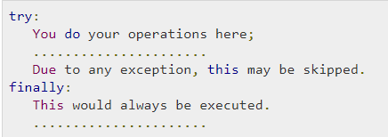
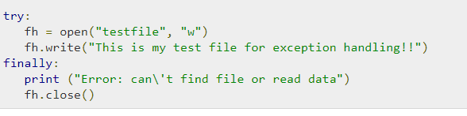
The try-finally Clause
You can use a finally: block along with a try: block. The finally: block is a place to put any code that must execute, whether the try-block raised an exception or not. The syntax of the try-finally statement is this −

Slide 146
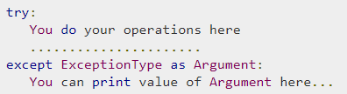
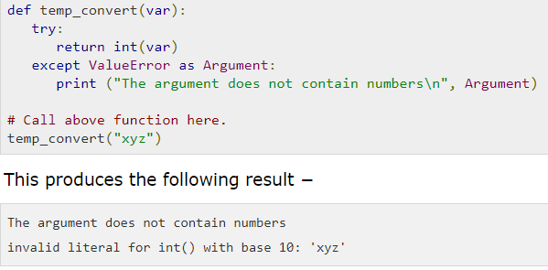
Argument of an Exception
An exception can have an argument, which is a value that gives additional information about the problem. The contents of the argument vary by exception. You capture an exception's argument by supplying a variable in the except clause as follows −

Slide 147


Raising an Exception
You can raise exceptions in several ways by using the raise statement. The general syntax for the raise statement is as follows −

Slide 148
Raising an Exception
You can raise exceptions in several ways by using the raise statement. The general syntax for the raise statement is as follows

Slide 149
OOP(Object Oriented Programs)
Python has been an object-oriented language since the time it existed. Due to this, creating and using classes and objects are downright easy. This chapter helps you become an expert in using Python's object-oriented programming support.

Slide 150
OOP Terminology
Class − A user-defined prototype for an object that defines a set of attributes that characterize any object of the class. The attributes are data members (class variables and instance variables) and methods, accessed via dot notation.
Class variable − A variable that is shared by all instances of a class. Class variables are defined within a class but outside any of the class's methods.
Data member − A class variable or instance variable that holds data associated with a class and its objects.

Slide 151
OOP Terminology
Function overloading − The assignment of more than one behavior to a particular function. The operation performed varies by the types of objects or arguments involved.
Instance variable − A variable that is defined inside a method and belongs only to the current instance of a class.
Inheritance − The transfer of the characteristics of a class to other classes that are derived from it.
Instance − An individual object of a certain class. An object obj that belongs to a class Circle, for example, is an instance of the class Circle.

Slide 152
OOP Terminology
Instantiation − The creation of an instance of a class.
Method − A special kind of function that is defined in a class definition.
Object − A unique instance of a data structure that is defined by its class. An object comprises both data members (class variables and instance variables) and methods.
Operator overloading − The assignment of more than one function to a particular operator.

Slide 153

Creating Class

Slide 154
Creating Instances
To create instances of a class, you call the class using class name and pass in whatever arguments its __init__ method accepts.
This would create first object of Employee class
----→emp1 = Employee("Zara", 2000)
This would create second object of Employee class
----→emp2 = Employee("Manni", 5000)

Slide 155
Accessing the Attributes
You access the object's attributes using the dot operator with object. Class variable would be accessed using class name as follows −

Slide 156

Accessing the Attributes

Slide 157
Destroying Objects (Garbage Collection)
Python deletes unneeded objects (built-in types or class instances) automatically to free the memory space. The process by which Python periodically reclaims blocks of memory that no longer are in use is termed as Garbage Collection.
Python's garbage collector runs during program execution and is triggered when an object's reference count reaches zero. An object's reference count changes as the number of aliases that point to it changes.

Slide 158
__del__
You normally will not notice when the garbage collector destroys an orphaned instance and reclaims its space. However, a class can implement the special method __del__(), called a destructor, that is invoked when the instance is about to be destroyed. This method might be used to clean up any non-memory resources used by an instance.

Slide 159

Example

Slide 160

Class Inheritance
Instead of starting from a scratch, you can create a class by deriving it from a pre-existing class by listing the parent class in parentheses after the new class name.
The child class inherits the attributes of its parent class, and you can use those attributes as if they were defined in the child class. A child class can also override data members and methods from the parent.

Slide 161


Example

Slide 162

Multiple inheritance

Slide 163
Validate class or object
You can use issubclass() or isinstance() functions to check a relationships of two classes and instances.
The issubclass(sub, sup) boolean function returns True, if the given subclass sub is indeed a subclass of the superclass sup.
The isinstance(obj, Class) boolean function returns True, if obj is an instance of class Class or is an instance of a subclass of Class

Slide 164

Overriding Methods
You can always override your parent class methods. One reason for overriding parent's methods is that you may want special or different functionality in your subclass.

Slide 165
Overloading Operators
Suppose you have created a Vector class to represent two-dimensional vectors. What happens when you use the plus operator to add them.
You could, however, define the __add__ method in your class to perform vector addition and then the plus operator would behave as per expectation

Slide 166

Example

Slide 167
Data Hiding
An object's attributes may or may not be visible outside the class definition. You need to name attributes with a double underscore prefix, and those attributes then will not be directly visible to outsiders.

Slide 168

Example

Slide 169
Regular Expression
A regular expression is a special sequence of characters that helps you match or find other strings or sets of strings, using a specialized syntax held in a pattern. Regular expressions are widely used in UNIX world.
The module re provides full support for Perl-like regular expressions in Python. The re module raises the exception re.error if an error occurs while compiling or using a regular expression.
We would cover two important functions, which would be used to handle regular expressions. Nevertheless, a small thing first: There are various characters, which would have special meaning when they are used in regular expression. To avoid any confusion while dealing with regular expressions, we would use Raw Strings as r'expression'.

Slide 170
Basic patterns that match single chars
1 | a, X, 9, < ordinary characters just match themselves exactly.
2 | . (a period) matches any single character except newline '\n'
3 | \w matches a "word" character: a letter or digit or underbar [a-zA-Z0-9_].
4 | \W matches any non-word character.
5 | \b boundary between word and non-word
6 | \s matches a single whitespace character -- space, newline, return, tab

Slide 171
Basic patterns that match single chars
7 | \S matches any non-whitespace character.
8 | \t, \n, \r tab, newline, return
9 | \d decimal digit [0-9]
10 | ^ matches start of the string
11 | $ match the end of the string
12 | \ inhibit the "specialness" of a character.

Slide 172
Compilation flags
Compilation flags let you modify some aspects of how regular expressions work. Flags are available in the re module under two names, a long name such as IGNORECASE and a short, one-letter form such as I.

Slide 173
Compilation flags
ASCII, A Makes several escapes like \w, \b, \s and \d match only on ASCII characters with the respective property.
DOTALL, S Make, match any character, including newlines
IGNORECASE, I Do case-insensitive matches
LOCALE, L Do a locale-aware match
MULTILINE, M Multi-line matching, affecting ^ and $
VERBOSE, X (for ‘extended’) Enable verbose REs, which can be organized more cleanly and understandably

Slide 174



Example

Slide 175



Example

Slide 176



Examples

Slide 177


Examples

Slide 178
Example

Slide 179
MultiThreading
Running several threads is similar to running several different programs concurrently, but with the following benefits −
Multiple threads within a process share the same data space with the main thread and can therefore share information or communicate with each other more easily than if they were separate processes.
Threads are sometimes called light-weight processes and they do not require much memory overhead; they are cheaper than processes.

Slide 180
Thread
A thread has a beginning, an execution sequence, and a conclusion. It has an instruction pointer that keeps track of where within its context is it currently running.
It can be pre-empted (interrupted).
It can temporarily be put on hold (also known as sleeping) while other threads are running - this is called yielding.
There are two different kind of threads −
kernel thread
user thread

Slide 181
Threads
Kernel Threads are a part of the operating system, while the User-space threads are not implemented in the kernel.
There are two modules which support the usage of threads in Python3 −
_thread
threading
The thread module has been "deprecated" for quite a long time. Users are encouraged to use the threading module instead. Hence, in Python 3, the module "thread" is not available anymore. However, it has been renamed to "_thread" for backwards compatibilities in Python3.

Slide 182


Slide 183

Class level Creating threads

Slide 184
Multiprocessing
When multiple processes are executed by the application is called multiprocessing

Slide 185

Example

Slide 186
Sockets
Sockets are the endpoints of a bidirectional communications channel. Sockets may communicate within a process, between processes on the same machine, or between processes on different continents.
Sockets may be implemented over a number of different channel types: Unix domain sockets, TCP, UDP, and so on. The socket library provides specific classes for handling the common transports as well as a generic interface for handling the rest.

Slide 187
Socket Module
socket_family − This is either AF_UNIX or AF_INET, as explained earlier.
socket_type − This is either SOCK_STREAM or SOCK_DGRAM.
protocol − This is usually left out, defaulting to 0.

Slide 188

Socket Client

Slide 189
Socket server methods
1 | s.bind() This method binds address (hostname, port number pair) to socket.
2 | s.listen() This method sets up and start TCP listener.
3 | s.accept() This passively accept TCP client connection, waiting until connection arrives (blocking).

Slide 190

Socket Server

